Slide 1
CS-360 Project: Gettysburg Carpool
By Linh T Phan, Prabesh Bista, & Spencer Hagan

Slide 2
Introduction
This project was meant to create an carpooling site for students to use on the Gettysburg College Campus. Some students are not able to have a car with them during their studies, and this site allows those with cars to offer rides to a variety of locations for other students like Walmart, Target, Airports, and more.

Slide 3
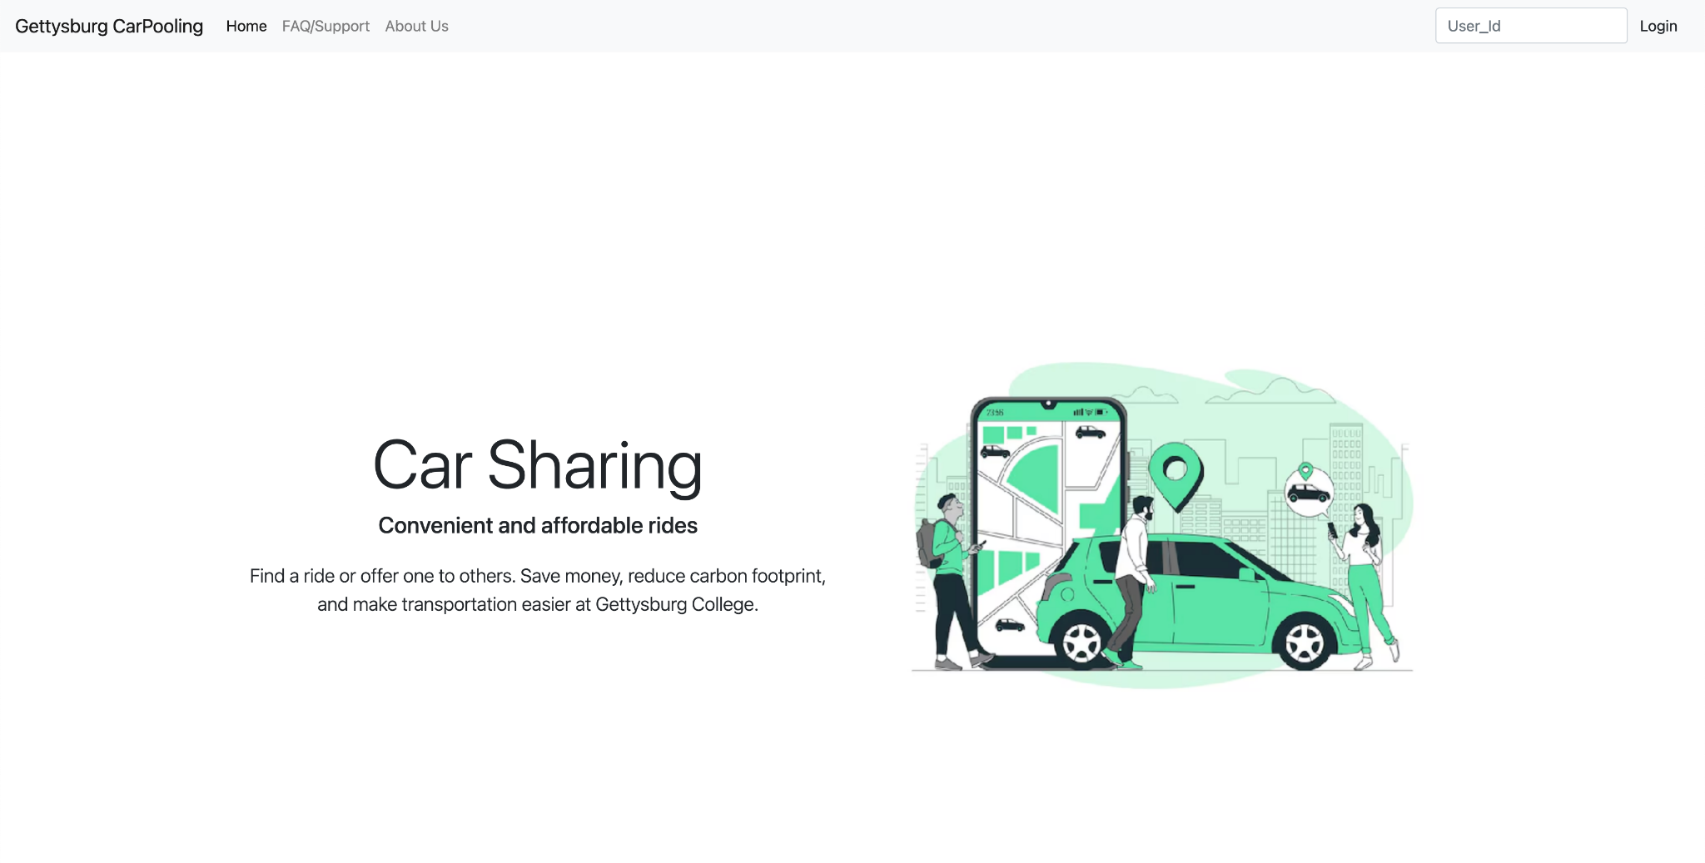
Landing Page + Signed-out navbar
Notes:
(Linh) Landing page for CarPooling, designed for users who are not logged in. It briefly introduces the platform's purpose - making ride-sharing easy and eco-friendly for the campus community - and provides quick access to support, info, and login via a simple top navbar.

Slide 4
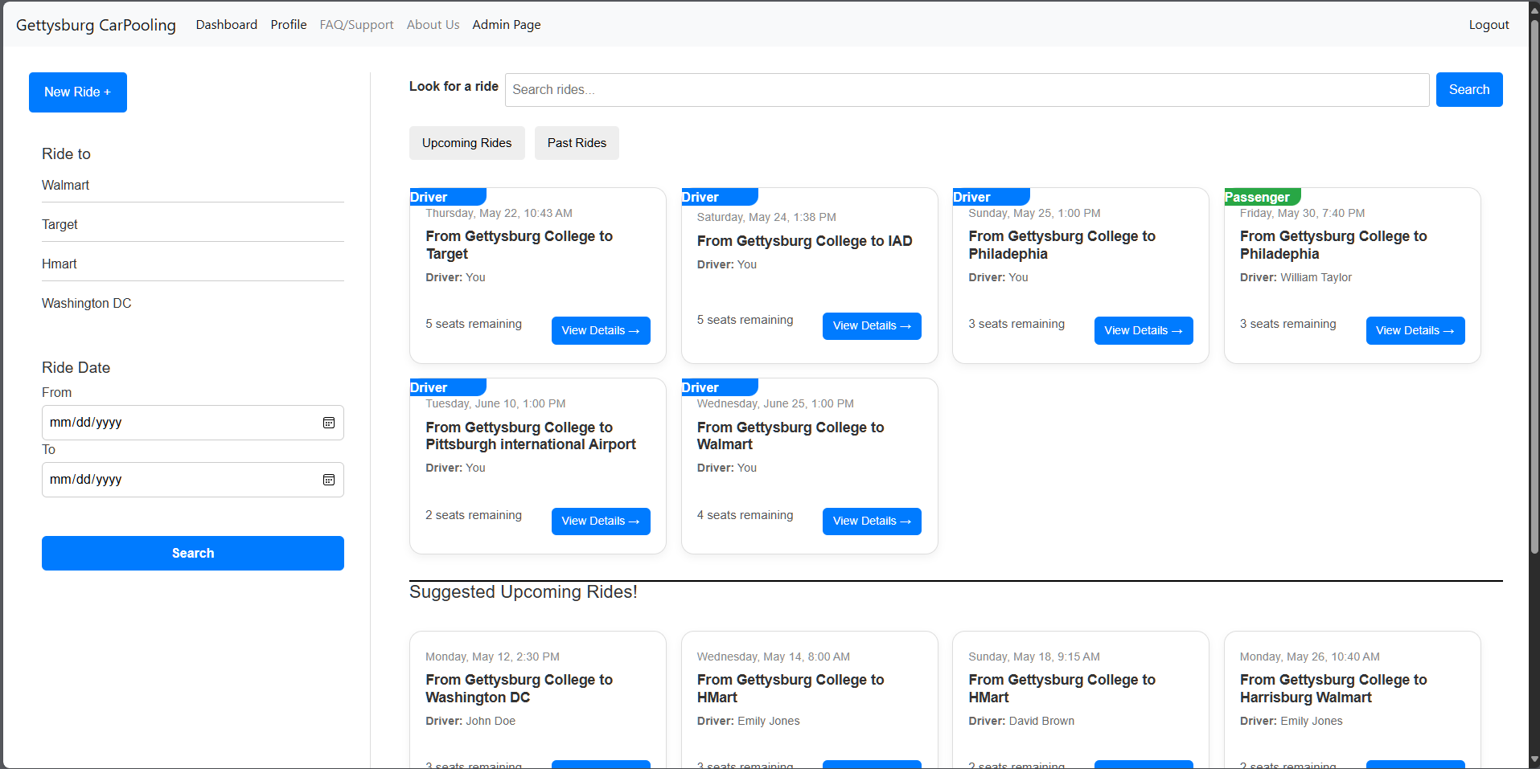
Dashboard + Signed-in Navbar
Notes:
(Prabesh) - On the right side of the page, the interface is divided into two main sections. The upper section displays a list of upcoming and past rides that the logged-in user is either a part of or has joined previously. Just below that, there's a section showing suggested rides, which are tailored for the user based on upcoming ride schedules. On the left side, we have a form that allows the current logged-in user to post a new ride. Additionally, users can browse through the ride list or use the search bar to find specific rides. The search functionality is designed to return the best possible matches based on the user’s input. Also, to make it easy for the user, we have implemented a visual difference between the ride the user is a driver and the ride where the user is a passenger.

Slide 5
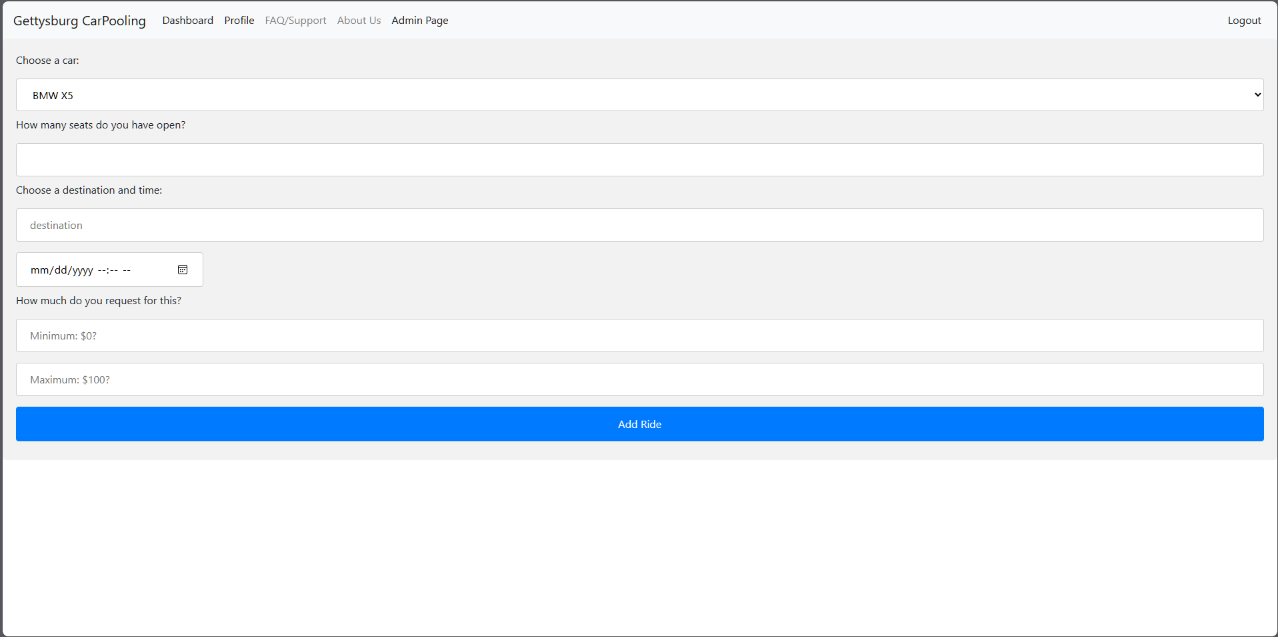
New Ride Form
Notes:
(Spencer) Here is the form generated when a user clicks the new ride button as seen in the previous slide on the dashboard. The user is asked:
for a car from their own cars if they have multiple
how many seats they’ll have open in case they’re already bringing someone or need the space as storage
the destination and time for the ride
a min and max price
This minimum and maximum are what they request as payment for the ride, which may be nothing or some money for gas, entirely up to the user. Once this info is all inputted, the add ride button will add the ride and redirect the user back to the dashboard, where they can see the newly made ride.

Slide 6
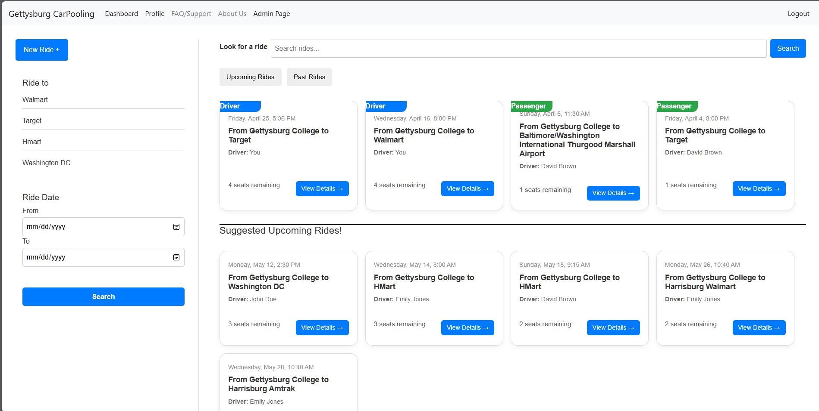
Dashboard with Past Rides
Notes:
(Prabesh) - When user clicks on the Past Rides button it will show the rides that the user was part of. Again, even for the past rides we have added a visual difference to differentiate between the ride the user was part of and the ride the user was driver itself. The past rides by the most recent ride that the user was part of, so that, it will quickly help the user to find the recent rides they were part of.
(Linh) This sidebar lets users filter rides by destination or ride date range. The top four most popular destinations are listed based on ride history. Users can select any combination of destination and date filters, but results only appear after clicking the Search button. If no filters are selected, all upcoming rides from today onward are shown. If user has a specific location they want to go to but it does not appear on short cut, they can search in search bar.
(Linh)

Slide 7
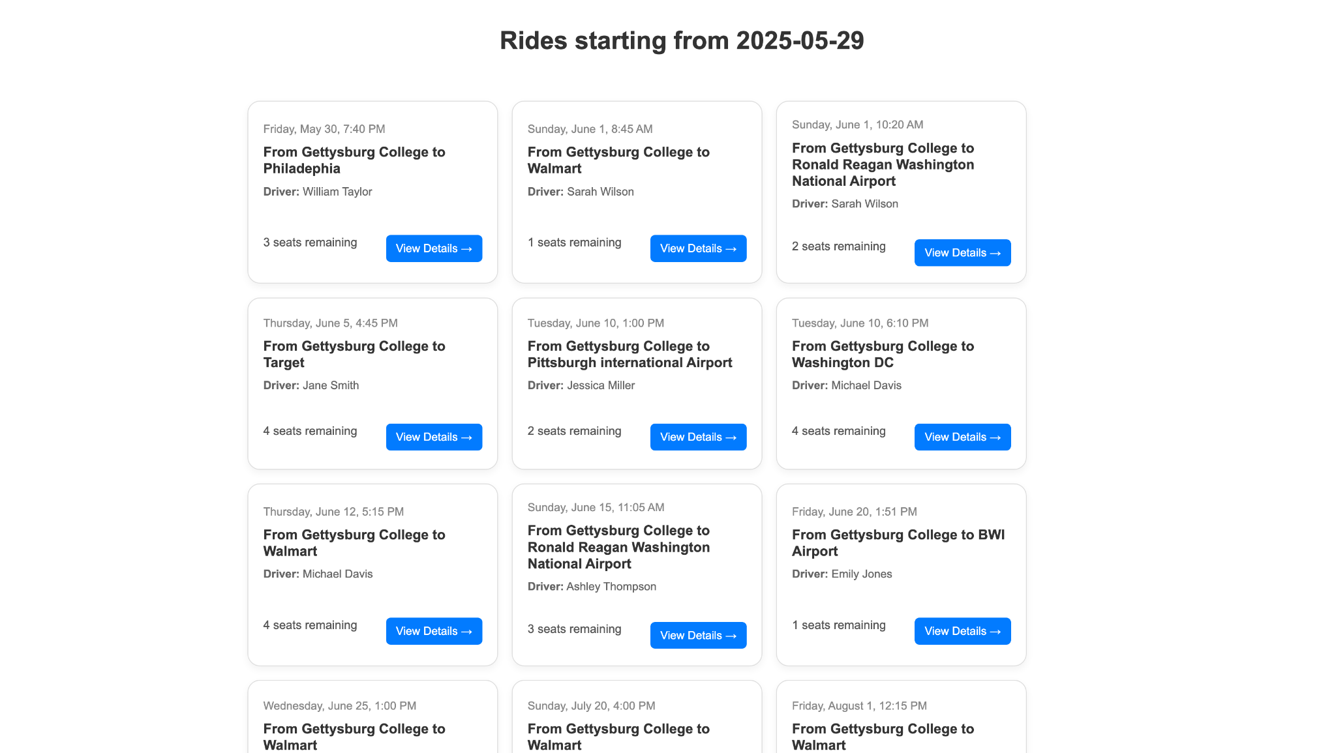
Ride Filter by Location & Date
Notes:
(Linh) This page displays all upcoming rides that match the selected location and/or date filters. Each ride card includes the departure date and time, destination, driver name, seats remaining, and a "View Details" button. Rides are shown in ascending order by date.

Slide 8
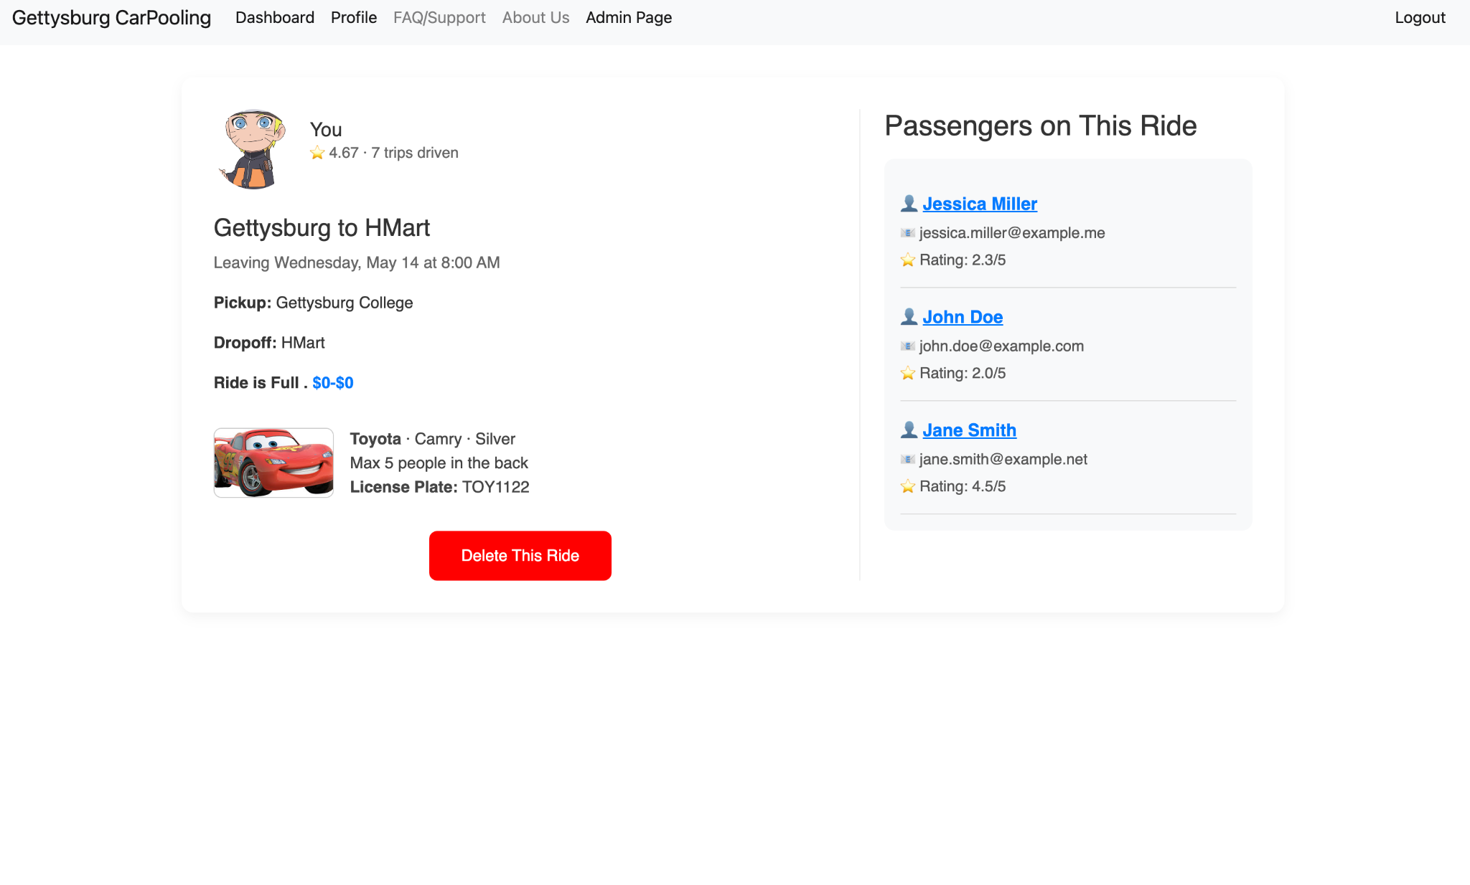
Ride Info (User is driver)
Notes:
(Prabesh) - If a user is a driver for the ride that user clicked on to see the details of the ride. The user will be able to see the info of the passenger and see the average rating of that passenger and see the most recent reviews as well as the contact email. And when the user clicks on the delete the ride it will cancel the ride and it will remove all the passenger from the ride. For future purposes, sending a notification would be really nice feature. Also there is info for the ride, where the user can see the info of the date the ride will take place, pickup location as well the drop off location and the full detail of the car that will be use during this ride. Ignore the car picture :)

Slide 9
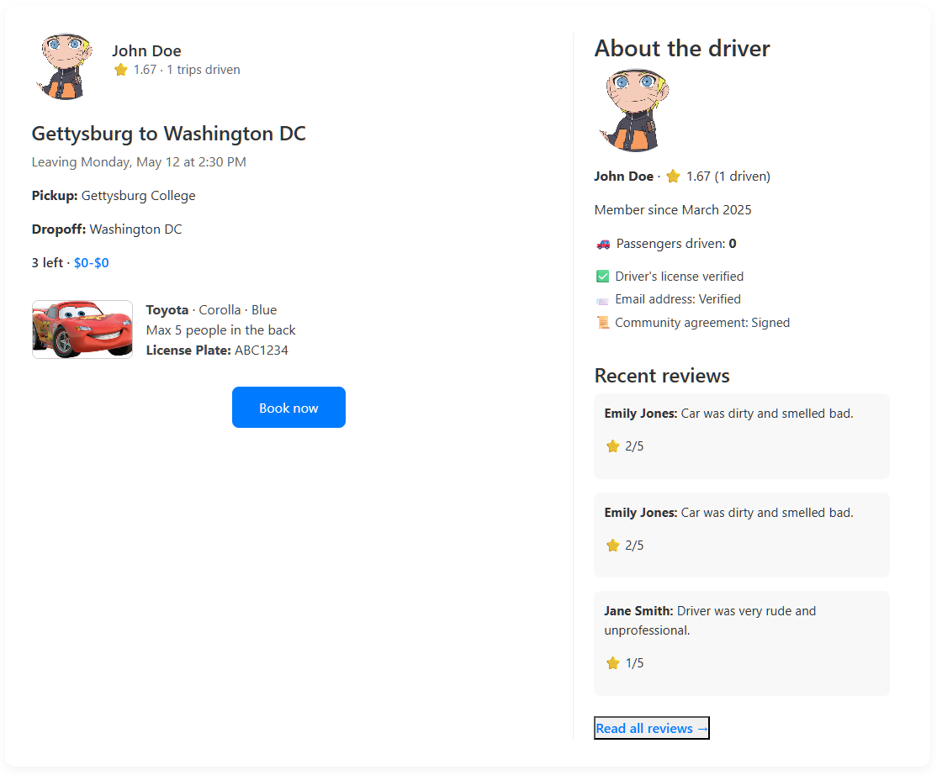
Ride Info (User is passenger/
looking to join)
Notes:
(Prabesh) - In the last slides we just had look at the UI if the user is a driver. But, what about when the user is the passenger for the ride? So, for the case where the use is passenger, application show information about the driver, on the right side as you can see there are most recent reviews about that driver. And when you clicked on the Read all reviews, the passenger would be able to see all the reviews that has been given to the driver of the ride. And the left side of the web page is similar to the last slide where important information like pickup, drop-off and the car information are shown.

Slide 10
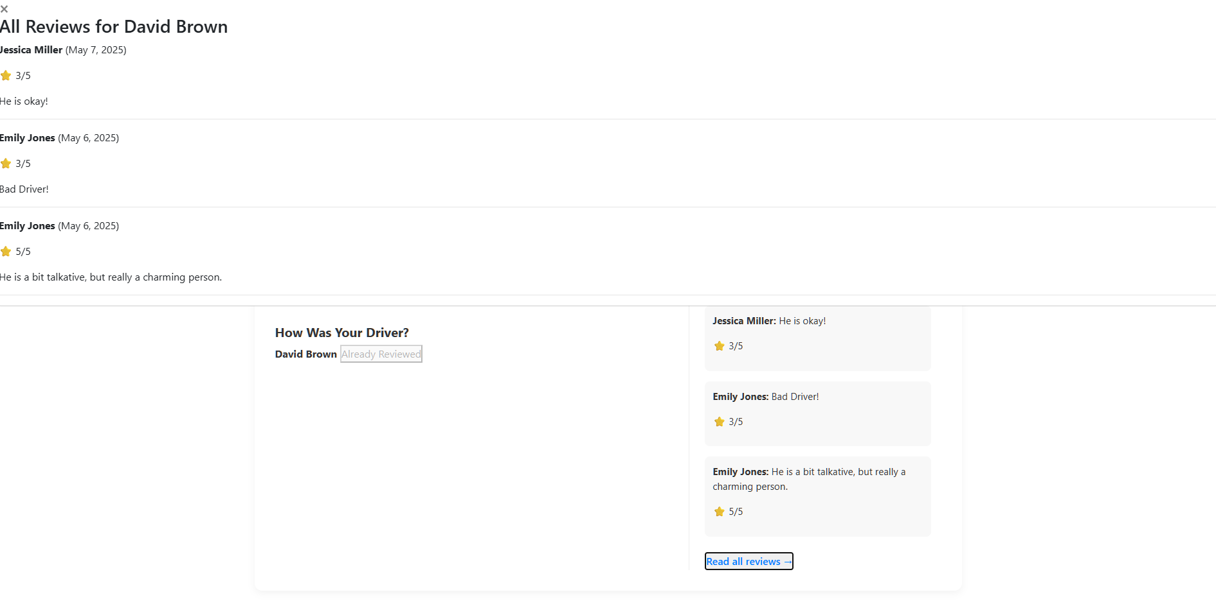
Ride Info (extra reviews)
Notes:
(Prabesh) - As I previously talked about Read all the reviews button, when the user clicks on that button it will show up All the reviews about the driver as you can see here.

Slide 11
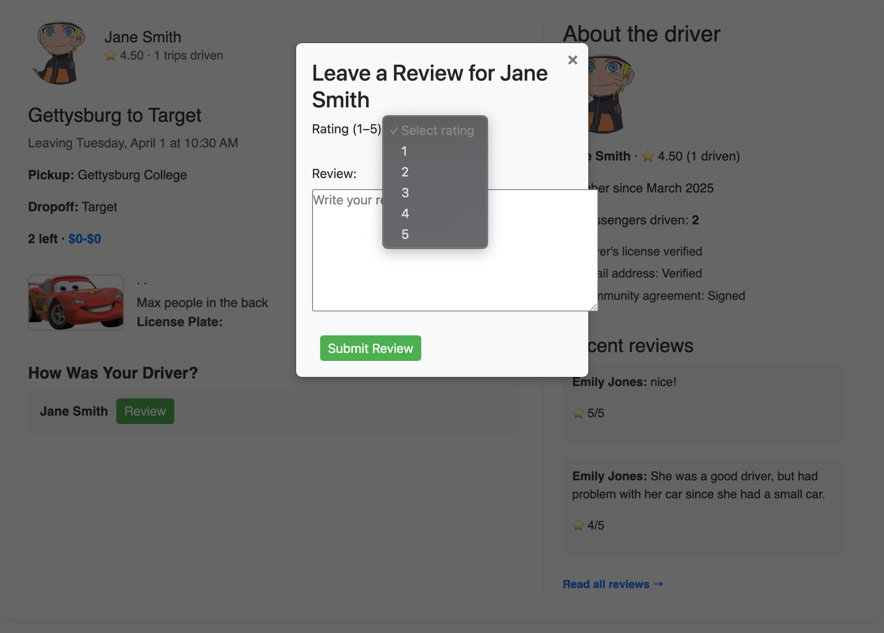
Review Form(For Passenger)
Notes:
(Prabesh) - If a user was a part of the ride, the user would be able to review the driver. As you can see on the slide, when the user clicks on that Review button. A form would pop-up, where user can leave a rating from 1-5, 1 being the lowest 5 being the highest. And also the user can write in detail review about the ride, the use feel about the driver. In-order to maintain the fair policy for the review system, the user would be allowed to review for once and can not edit the review for the driver after it has been submitted. If the user has previously reviewed the driver, then the Review button would change to Already Review where the user would not be allowed to click and the button would look like a disabled button.

Slide 12
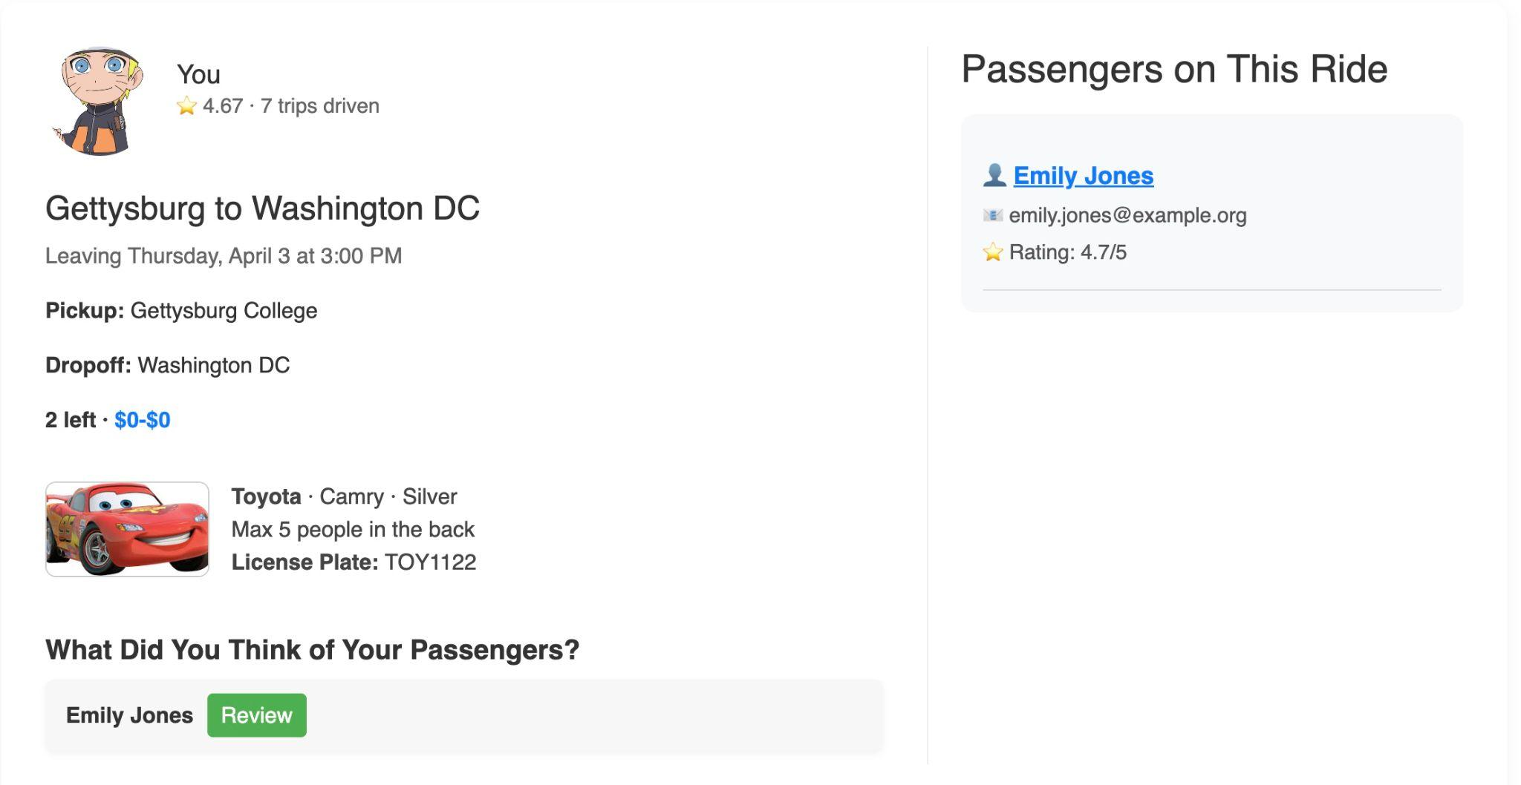
Review Form(Driver)
Notes:
(Prabesh) - In-order to be fair with the driver, we also have implemented a feature where the driver would be able to review the passenger that were part of this ride. The review form is same as the one that I have shown previously. And again, if the driver have already reviewed the passenger the green button would change to already reviewed button and the driver will no longer be able to review again the passenger.

Slide 13
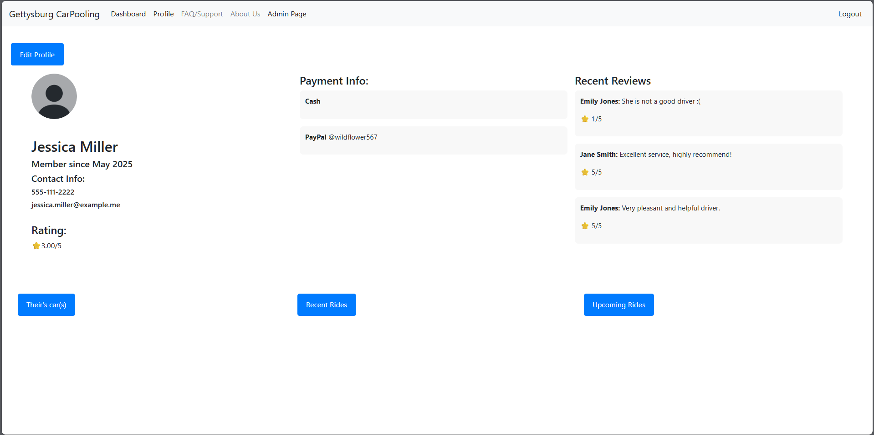
User Profile
Notes:
(Spencer) This page is accessed through the Profile nav option in the navbar, and generates the profile page for the currently logged in user. Here a user can see their info such as how long they’ve been on the site, their contact info, rating, etc. Logged in user are also given the option to edit their info, which we’ll show later on.
The user is also given buttons on the bottom of the page to display more information about themselves, such as:
Their cars
Their last 3 rides
Their next 3 rides.
This info and page is designed to give someone at least a basic understanding of a user, how trustworthy they might be, and their typical destinations.

Slide 14
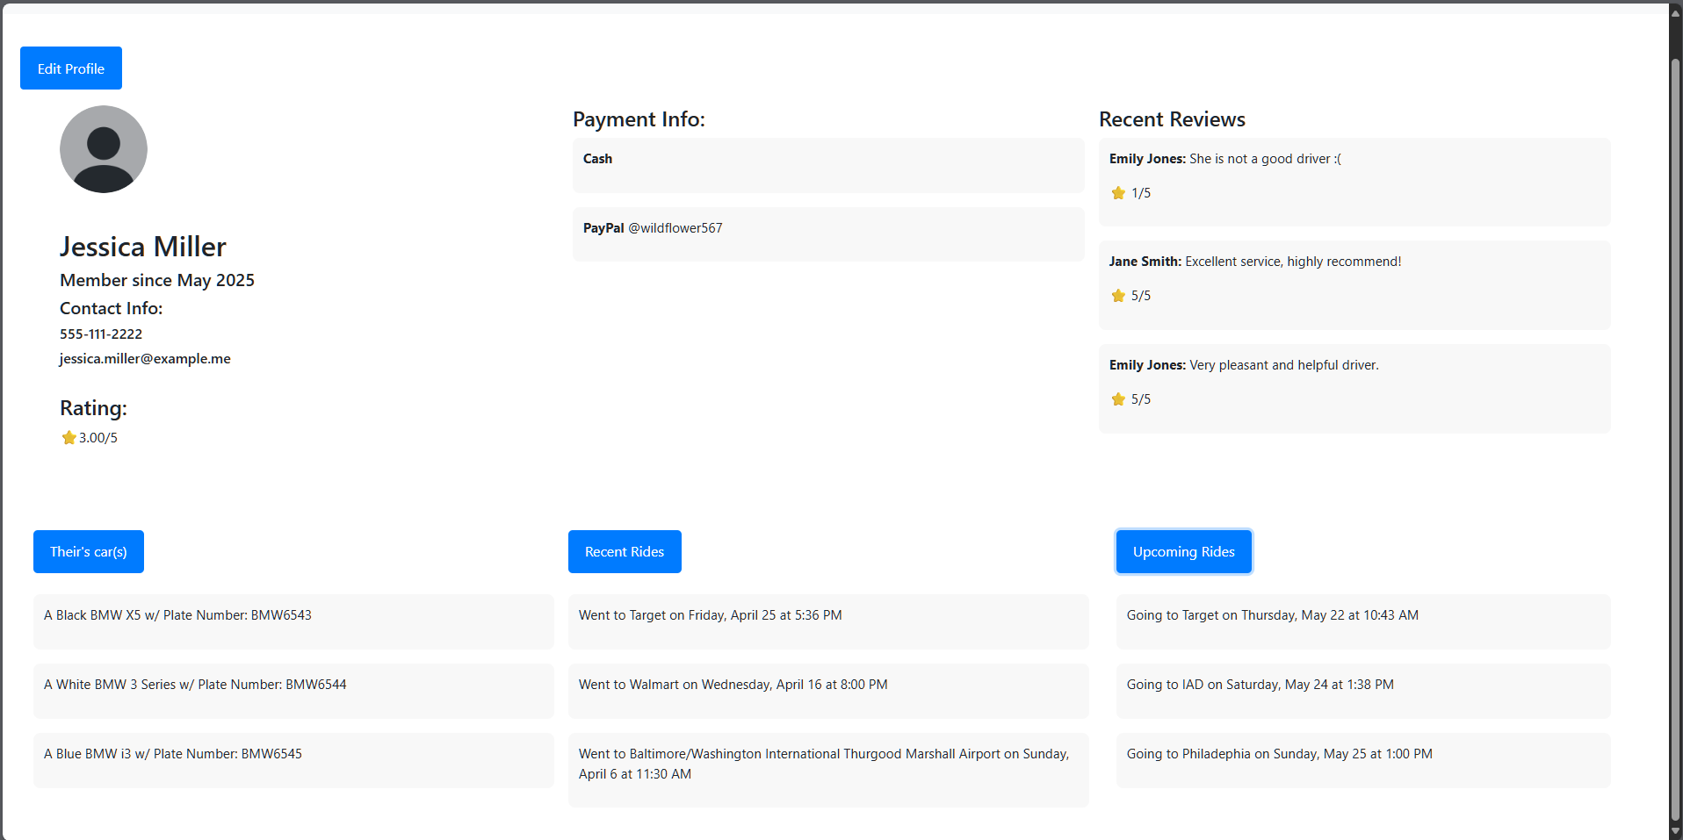
User Profile + Added Info
Notes:
(Spencer) This gives you an example of what the extra info appears as on the profile page if their respective buttons are selected.
This info can be hidden or shown as much as the user likes, and will automatically generate when info changes, such as an upcoming ride turning into a recent ride by date.

Slide 15
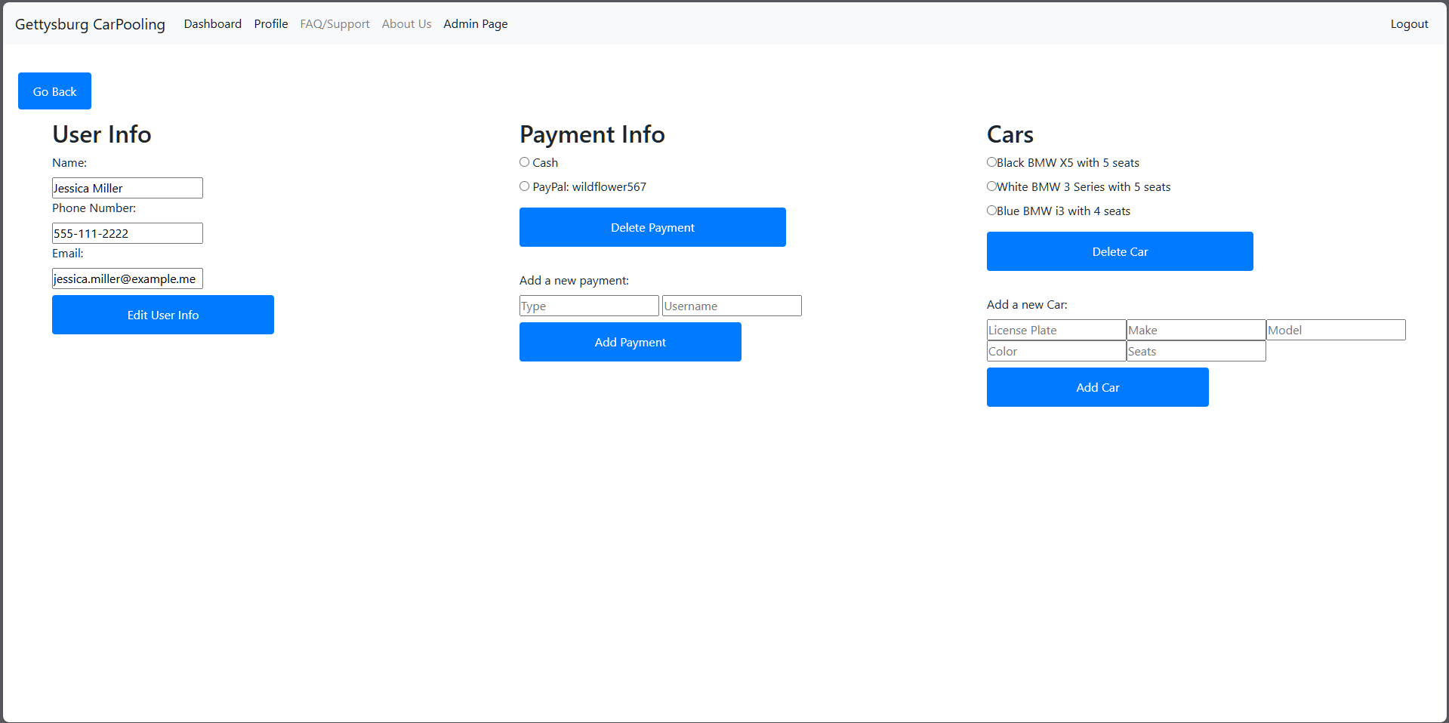
Edit User Info Form
Notes:
(Spencer) This form is generated when a logged-in user selects the “Edit Profile” button seen on the profile page. Here a user can edit a variety of info about themselves:
On the far right, a user can change their name and contact info
In the Middle, a user can delete current payment info or add a new payment type
On the far left, a user can delete an existing car or add a new one
This page allows the user to dynamically edit their own information to then be used in the rides.

Slide 16
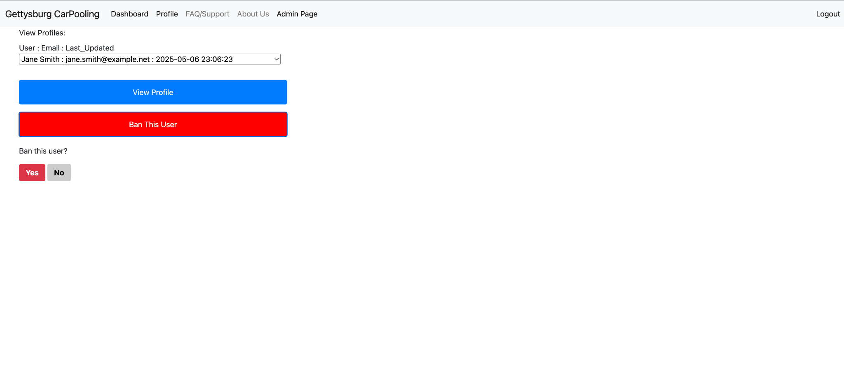
Admin Page
Notes:
(Linh) This is the Admin Page where administrators can view and manage user accounts. After selecting a user from the dropdown (displayed as “Name : Email : Last_Updated”), the admin can choose to view the user’s profile or ban the user. Clicking “Ban This User” reveals a confirmation prompt with “Yes” and “No” buttons to finalize the action.

Slide 17
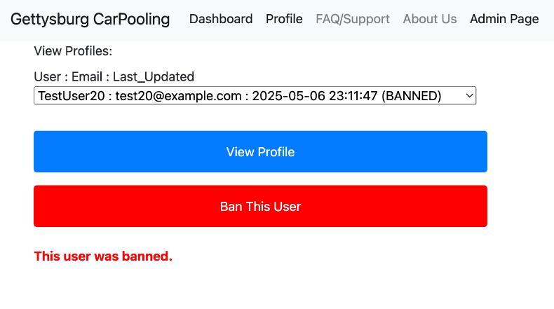
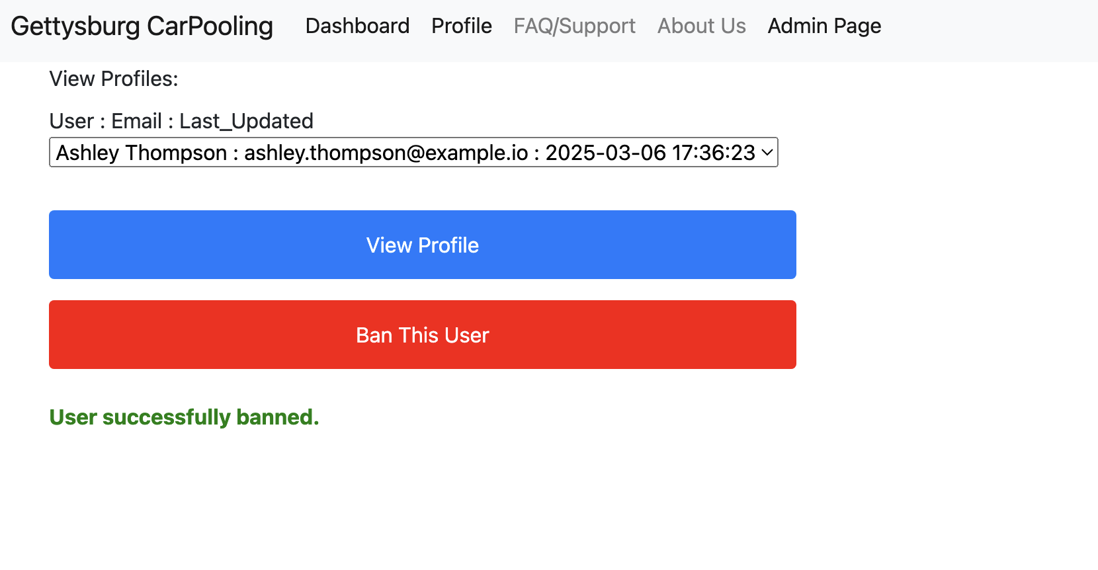
Admin Page - Ban user
Notes:
(Linh) This view shows two admin scenarios for banning users. On the left, the admin selects a user already banned - indicated by the "(BANNED)" tag in the dropdown and a red message stating, "This user was banned." On the right, after banning a user successfully, the interface confirms with a green message: "User successfully banned." This provides clear visual feedback for user status changes within the admin panel.

